Slide 1
SRS – Hostel management system
Version: 1.0

Slide 2
01
02
Table of Contents
03
04
Mercury
Describe the topic here
Mars
Describe the topic here
Jupiter
Describe the topic here
Saturn
Describe the topic here

Slide 3
01
Introduction
Enter a subtitle here if you need it

Slide 4
Purpose of HMS V-1.0
Streamlining hostel operations. Modules:
Incident
Room Allocation
Feedback
Staff Management
Mess
Fee Submission
Authentication

Slide 5
Project Scope
Inclusions:
Exclusions:
Modules overview
No financial system integration, limited analytics

Slide 6
References
Relevant Documents
01
IEEE Std 830-1998 university polocies
External References
02
DBMS, Django, Web browsers

Slide 7
External Source of Ideas
Mercury
Saturn
Jupiter
It’s the closest planet to the Sun
Saturn is a gas giant and has rings
It’s a gas giant and the biggest planet

Slide 8
You Have Three Columns Here
Mercury
Saturn
Jupiter
It’s the closest planet to the Sun
Saturn is a gas giant and has rings
It’s a gas giant and the biggest planet

Slide 9
Product Roadmap Process
Viable Product
Extended MVP
Launch
Minimal Viable Product
Concept
Test
Analysis
Check
Position
Selling
Build

Slide 10
Creativity
Concept
Design
Build the Product
Viable Product
Analysis
Test
Position
Check
Selling

Slide 11
Feasibility Review
Mercury
Jupiter
It’s the smallest planet of them all
It’s the biggest planet in the Solar System
Saturn
Mars
It’s a gas giant and has several rings
It’s a cold place. It’s full of iron oxide dust
Venus
Neptune
This planet has a very beautiful name
It’s the farthest planet from the Sun

Slide 12
New Product Analysis
Venus
Venus is the second planet from Sun
Mars
Mars is a cold place full of iron oxide
100%
75%
85%
80%
60%
60%
Saturn
Saturn is a gas giant and is hot
2020
2021

Slide 13
Detailed Analysis
Strengths
02
Weaknesses
Mercury is the smallest planet in the Solar System
Jupiter is a gas giant and the biggest planet of the mall
01
SWFB
03
Benefits
Features
Venus has a beautiful name and is the second planet
Despite being red, Mars is actually a cold place
04

Slide 14
Porter’s Five Forces Analysis
Threat of New Entrants
Bargaining Power of Buyers
Neptune is the farthest planet from the Sun
Mercury is the closest planet to the Sun
Competitors
Earth is the third planet from Sun
Bargaining Power of Suppliers
Substitute Products
This planet has a very beautiful name
Despite being red, Mars is actually a cold place

Slide 15
Product Life Cycle Stages
Introduction
Growth
Maturity
Decline
Product Development
Testing
Implementation
Enhancement
R&D
Margining
Maintenance
Technical Support

Slide 16
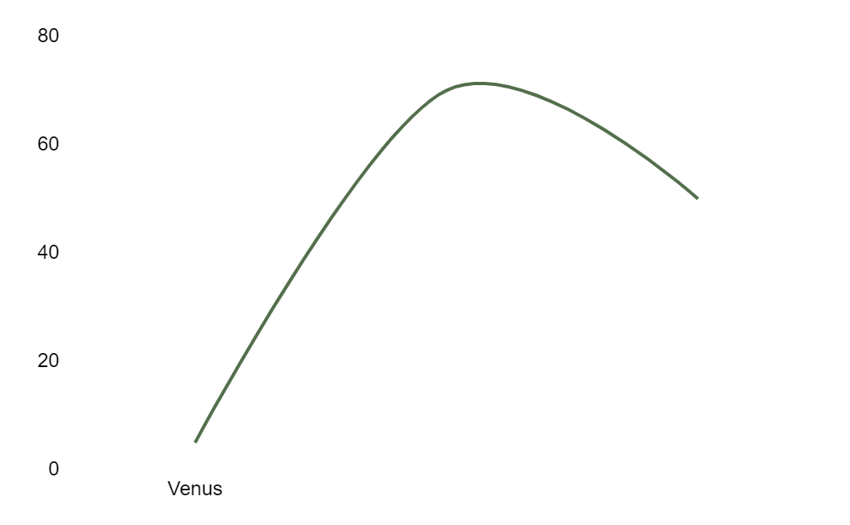
Product Life Cycle Stages
Introduction
Introduction
Growth
Maturity
Decline
Venus has a beautiful name
Growth
Pluto is now a dwarf planet
Sale
Maturity
Earth is the only planet with life
Jupiter
Time
Jupiter is the biggest planet

Slide 17
The Slide Title Goes Here!
Do you know what helps you make your point clear? Lists like this one:
They’re simple
You can organize your ideas clearly
You’ll never forget to buy milk!
And the most important thing: the audience won’t miss the point of your presentation

Slide 18
Maybe You Need Two Lists?
List 1
List 2
Write here what you need
Write here what you need
Write here what you need
Write here what you need
Write here what you need
Write here what you need
Write here what you need
Write here what you need
Write here what you need
Write here what you need
Write here what you need
Write here what you need

Slide 19
Introduction Stage
Venus
Pluto
Earth
Jupiter
Mars
Venus is the Roman goddess of love
Pluto is now considered a dwarf planet
Earth is the only planet with life
Jupiter is the biggest planet of them all
Despite being red, Mars is a cold place

Slide 20
Quality Attributes
Availability
Portability
Aim for 99.9% availability
Compatibility with major browsers and operating systems
Correctness
Reliability
Consistent and correct results
Minimize system failures and errors
Flexibility
Reusability
Customizable settings
Modular and well-documented code

Slide 21
Growth Stage
Mercury
Mars
Neptune
Saturn
Mercury is the closest planet to the Sun
Despite being red, Mars is a cold place
Neptune is the farthest planet from the Sun
Saturn is a gas giant and has several rings

Slide 22
Growth Stage
Mercury
Mars
Mercury is the closest planet to the Sun
Despite being red, Mars is a cold place

Slide 23
BCG Matrix
30%
20%
10%
0%
0
0,5
1
1,5
2
Mars
Jupiter
Venus
Saturn
Despite being red, Mars is cold
Jupiter is the biggest planet
Venus has a beautiful name
Saturn is the ringed planet

Slide 24
Market Segmentation
Venus
Mars
Mercury
Age
Brand Loyalty
Jupiter
Saturn
Gender
Benefits Sought
Nationality
Lifestyle
Age
User Status
Occupation
Personality
Gender
Usage Rate
Ethnicity
Interests
Nationality
Occasion
Income
Climate

Slide 25
Market Segmentation
Teen
Young Adult
Adult
Despite being red, Mars is a cold place
Jupiter is the biggest planet of them all
Venus has a poisonous atmosphere
Student
Worker
Worker

Slide 26
Sector News
Venus
Mars
Mercury
Venus has a beautiful name and is the second planet from the Sun
Despite being red, Mars is actually a cold place full of iron oxide dust
Mercury is the closest planet to the Sun and the smallest of them all

Slide 27
Sector News
Jupiter
Mars
Venus
Neptune
Mercury
Saturn
Jupiter is the biggest planet of them all
Despite being red, Mars is a cold place
Venus has a poisonous atmosphere
Neptune is the farthest planet from the Sun
Mercury is the smallest planet of them all
Saturn is a gas giant and has several rings

Slide 28
Product Segmentation
81%
67%
47%
38%
23%
Mars
Jupiter
Venus
Saturn
Neptune
Despite being red, Mars is a cold place
Jupiter is the biggest planet of them all
Venus has a poisonous atmosphere
Saturn is a gas giant and has several rings
Neptune is the farthest planet from the Sun

Slide 29
Product Segmentation
25%
60%
15%
Venus
Mars
Mercury
Venus has a beautiful name and is the second planet from the Sun
Despite being red, Mars is actually a cold place full of iron oxide dust
Mercury is the closest planet to the Sun and the smallest of them all

Slide 30

A picture is worth a thousand words

Slide 31

A picture is worth a thousand words

Slide 32

A picture reinforces the concept
Images reveal large amounts of data, so remember: use an image instead of a long text

Slide 33
AWESOME WORDS

Slide 34
Psychographic Segmentation
Saturn
Mercury
Saturn is a gas giant made of hydrogen and helium
Mercury is the smallest planet in the Solar System
Jupiter
Neptune
Jupiter is a gas giant and the biggest planet
Neptune is the farthest planet from the Sun
Venus
Mars
Venus is the second planet from the Sun
Despite being red, Mars is actually a cold place

Slide 35
External Interface Requirements
User Interfaces
Hardware Interfaces
Jupiter is a gas giant and the biggest planet
Neptune is the farthest planet from the Sun
Communications Interfaces
Software Interfaces
Saturn is a gas giant made of hydrogen and helium
Despite being red, Mars is actually a cold place

Slide 36
Manufacturing Plan
Quarter 1 |  |  | Quarter 2 |  |  | Quarter 3 |  |  | Quarter 4
JAN | FEB | MAR | APR | MAY | JUN | JUL | AUG | SEP | OCT | NOV | DIC
Project 1
 | Project 2
 |  |  |  |  |  |  | Project 3
 |  |  | Project 4
 |  |  |  | Project 5
 |  |  |  |  |  |  |  | Project 6
 |  |  |  |  |  |  | Project 7
 | Project 8
Mars
Jupiter
Uranus
Venus
Saturn

Slide 37
Manufacturing Plan
Q1
Q2
Q3
Q4
JAN | FEB | MAR | APR | MAY | JUN | JUL | AUG | SEP | OCT | NOV | DIC
Product/Capac. | Advertising |  | Budget
Quantity | Sales | Marketing | Cash Flow
Quality |  |  | Financial Decisions
Form

Slide 38
Marketing Launch Plan
Venus
Saturn
Neptune
Venus has a very beautiful name
Saturn is a gas giant and has rings
Neptune is the farthest planet
Mercury
Mars
Jupiter
Mercury is the smallest planet
Despite being red, Mars is a cold place
Jupiter is a gas giant and the biggest

Slide 39
Marketing Launch Plan
1
2
3
Mercury
Venus
Mars
Mercury is the smallest planet
Venus has a beautiful name
Despite being red, Mars is very cold

Slide 40
Marketing Communication Mix
Project Manager
Content Manager
It’s the second-brightest natural object
Despite being red, Mars is a very cold place
Publicist
Graphic Team
It’s a gas giant and the
biggest planet
Yes, this is the ringed one. It’s a gas giant

Slide 41
Repositioning Product
Mercury
Venus
Mercury is the closest planet to the Sun and the smallest one in the Solar System—it’s a bit larger than the Moon
Venus has a very beautiful name and is the second planet from the Sun. It’s hot and has a very poisonous atmosphere

Slide 42
Repositioning Product
Despite being red, Mars is a cold place, not hot. It’s full of iron oxide dust, which gives reddish cast
50%
It’s a gas giant and the biggest planet in the Solar System. It’s alsos the fourth-brightest object in the sky
20%
30%
Yes, this is the ringed one. It’s a gas giant, composed mostly of hydrogen and helium

Slide 43
Operations Plans
 | Category | Key Initiatives | Prioritization | Project Lead
 | Sales
 | Marketing
 | Operation
 | People
 | Financial

Slide 44
Business & Financial Analysis
Investments | Venus | Mercury | Mars | Jupiter
Equipment | $21.00 | $29.00 | $35.00 | $14.00
Land Cost | $9.00 | $6.00 | $21.00 | $17.00
Interior Cost | $13.00 | $11.00 | $10.00 | $21.00
Employee Cost | $18.00 | $14.00 | $6.00 | $27.00
Marketing Cost | $5.00 | $3.00 | $12.00 | $15.00
Other Cost | $12.00 | $20.00 | $9.00 | $8.00
Total | $78.00 | $83.00 | $93.00 | $102.00

Slide 45
Business & Financial Analysis
45%
80%
65%
Mercury
Venus
Mars
Mercury is the smallest planet
Venus has a beautiful name
Despite being red, Mars is very cold

Slide 46
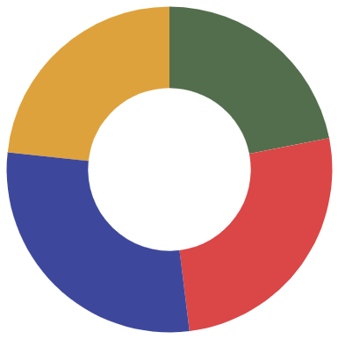
Budget
Venus
Venus is terribly hot
$83
$78
Mercury
Mercury is the smallest
Mars
Mars is a cold place
$102
$93
Jupiter
Follow the link in the graph to modify its data and then paste the new one here. For more info, click here
Jupiter is a gas giant

Slide 47
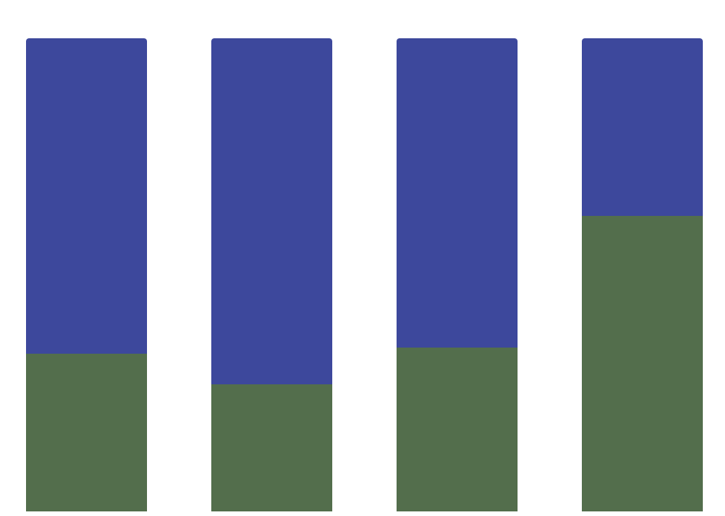
Budget
Mercury
Mercury is the closest planet to the Sun and the smallest one of them all
A
B
C
D
Jupiter
Venus has a very beautiful name and is the second planet from the Sun
Follow the link in the graph to modify its data and then paste the new one here. For more info, click here

Slide 48
Feasibility Review
Mercury
Saturn
Mercury is the smallest planet
Saturn is a gas giant and has rings
Neptune
Jupiter
Neptune is very far away from Earth
Jupiter is the biggest planet of them all
Venus
Mars
Venus has a very beautiful name
Despite being red, Mars is cold

Slide 49
Feasibility Review
Neptune
Mercury
Neptune is very far away from Earth
Mercury is the
Smallest planet
Jupiter
It’s a gas giant and the biggest planet

Slide 50
Launch Monitoring Dashboard
Project
Priority
Status
It’s the only one that harbors life
High
In Progress
It’s a gas giant and has several rings
Low
Completed
It’s a gas giant and the biggest planet
Normal
Not Started
It’s the fourth-largest planet of them all
High
Done

Slide 51
Launch Monitoring Dashboard
Structure
Systems
Mars is the fourth planet from the Sun
It is the fourth-largest planet by diameter
25%
80%
Low
In progress
High
Completed

Slide 52

External Interface Requirements
Internet Communication: Communication over the internet
Email Notifications: Important updates via email
API Integration: Potential integration with university systems
Security Protocols: Secure communication protocols

Slide 53
Tablet App
You can replace the image on the screen with your own work. Just delete this one, add yours and center it properly

Slide 54
Mobile Web
You can replace the image on the screen with your own work. Just delete this one, add yours and center it properly

Slide 55
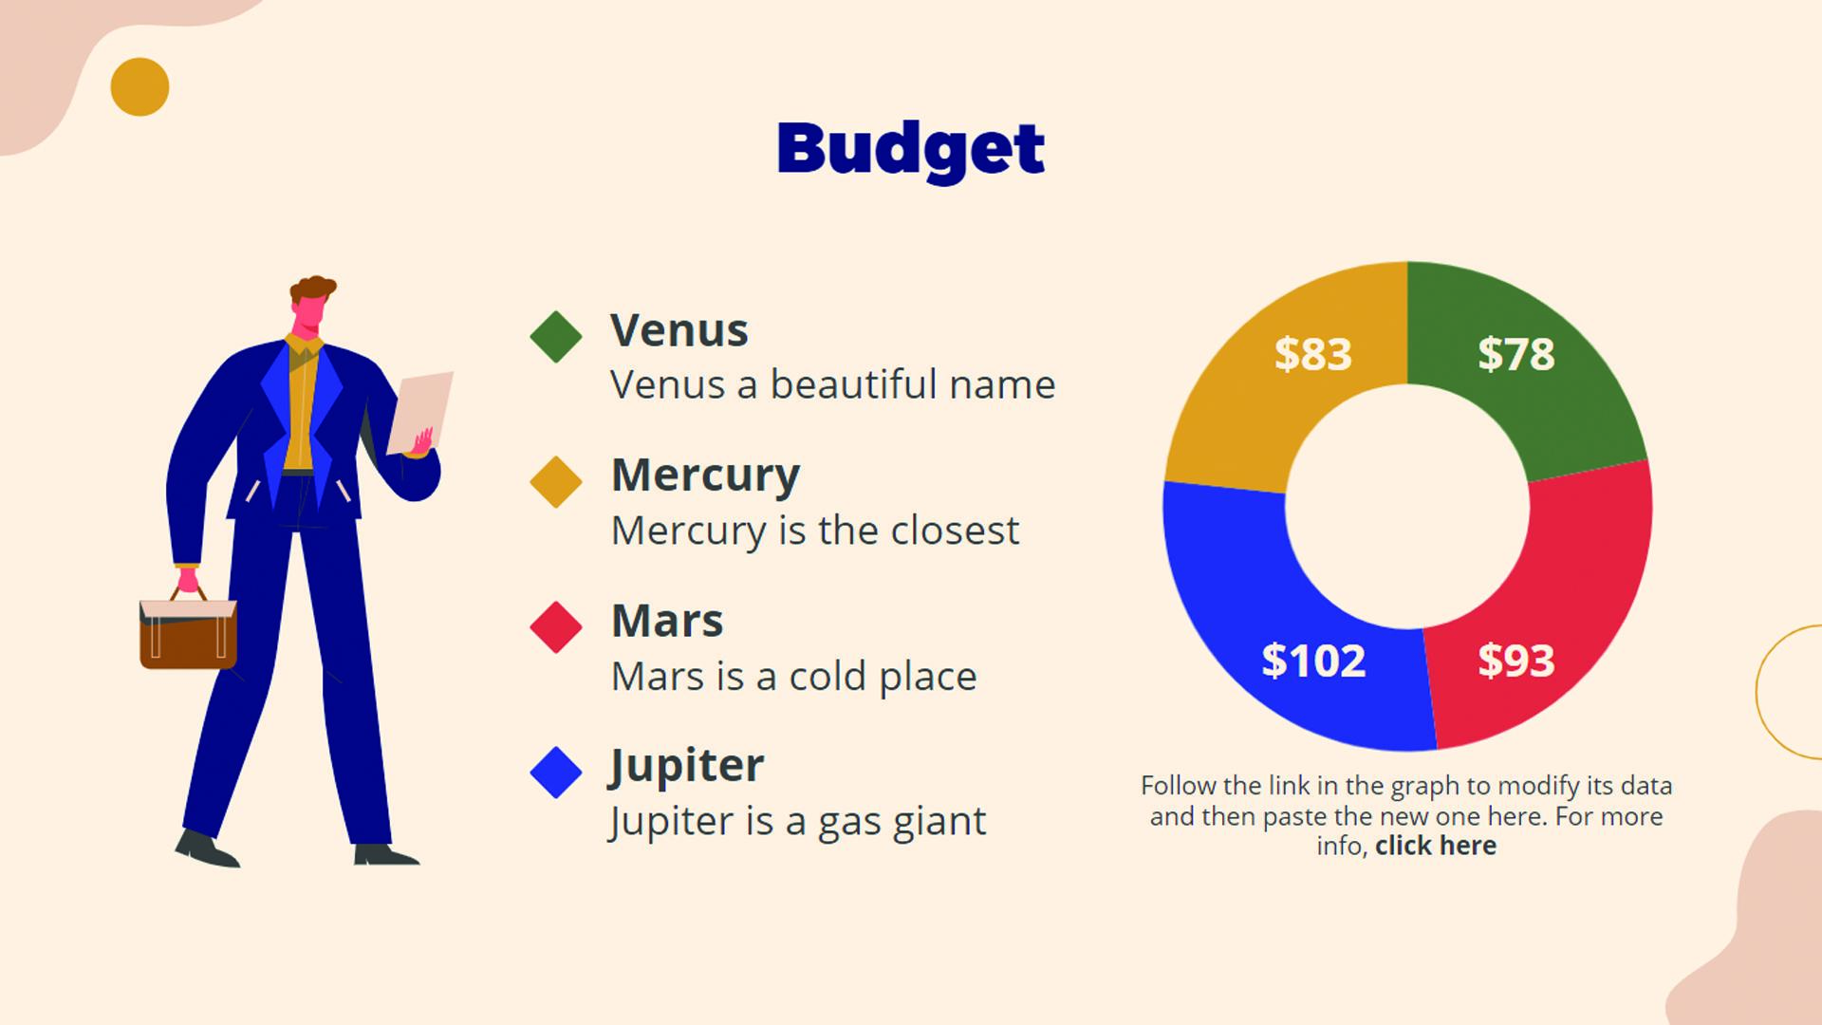
Laptop
You can replace the image on the screen with your own work. Just delete this one, add yours and center it properly

Slide 56


Our Team
Miguel James
Sarah Galvan
You can talk about this person here
You can talk about this person here

Slide 57
Thanks!
Do you have any questions? youremail@freepik.com
+91 620 421 838 yourcompany.com
Please keep this slide for attribution

Slide 58
Setup and Settings Icon Pack

Slide 59
Alternative Resources

Slide 60
Alternative Resources

Slide 61
Alternative Resources

Slide 62
Alternative Infographic Elements

Slide 63
Alternative Resources
Photos
Multiracial employees shaking hands in office
Colleagues in contemporary office coworking
African american man sitting copy space
Colleagues in contemporary office coworking
Smiling young businessman and businesswoman giving high five in front of corporate building
Man looking at watch and talking on phone on his way to work

Slide 64
Resources
Vectors
Business infographic design
Business infographic template with puzzle
Businesswomen and businessmen with devices
Businesswomen and businessmen working
Copyright landing page template
Round infographic of human brain
People with technology devices
Photos
Event manager showing laptop to happy woman
Group of three modern architects

Slide 65
Use our editable graphic resources...
You can easily resize these resources without losing quality. To change the color, just ungroup the resource and click on the object you want to change. Then, click on the paint bucket and select the color you want. Group the resource again when you’re done. You can also look for more infographics on Slidesgo.

